Slide 1
Horizon Implementation Day
Novelties in Work Programme 2026-2027 General Annexes
20 January 2026

Slide 2

Agenda
    9:00 Welcome
    9:15 Novelties in the application process + Q&A
    10:30 Novelties in Choose Europe for Science + Q&A
    11:30 EU Funding & Tenders Portal: 2-factor authentication

Slide 3
Novelties in WP 2026-2027
The work programme is designed to be more strategic, focused, simpler, and accessible, with a reduction in fragmentation of the available budget.
It includes a new part called "Horizontal Activities" which groups the horizontal calls and aims to create critical mass and avoid duplication of budget.
It allocates €50 million to the "Choose Europe for Science" initiative to improve long-term fellowships and postdoctoral career stability.
It encourages international cooperation, but also imposes restrictions on participation in certain topics, including those related to 5G, 6G, and communication network equipment.
It has been simplified, with a 33% reduction in length, fewer and more concise topics, and a relative decrease in one-project-only topics.
It has increased the use of lump sums, with at least 50% of the Horizon Europe call budget allocated through lump sums.
It includes simplified proposal forms implying a reduction of the standard page limits by 5 pages.

Slide 4
Upcoming info days
20-21 January EU Missions info day
22-23 January Cluster 6 info day
22 January WIDERA info day
28 January Cluster 4 AI, Data, Robotics
18 March Research Infrastructures info day
Information on future info days will be published in the EU Funding & Tenders Portal

Slide 5
Novelties in the application process
Horizon Europe

Slide 6
Outline
    Update of evaluation criteria and application forms
    Reduction of overall time to grant in two-stage calls
    Economic security
    Newly associated countries

Slide 7
Update of evaluation criteria and application forms
Horizon Europe

Slide 8

Updated criterion RIA, IA, CSA, COFUND
  Criterion 2, Impact, has been updated for RIA, IA, CSA and COFUND type of actions.
  The "likely scale and significance of the contributions from the project" is no longer part of the evaluation of impact.
  The updated impact criterium reads:
  Credibility of the pathways to achieve the expected outcomes and impacts specified in the work programme.
  Suitability and quality of the measures to maximise expected outcomes and impacts, as set out in the dissemination and exploitation plan, including communication activities.
  Excellence and implementation criteria are unchanged.

Slide 9
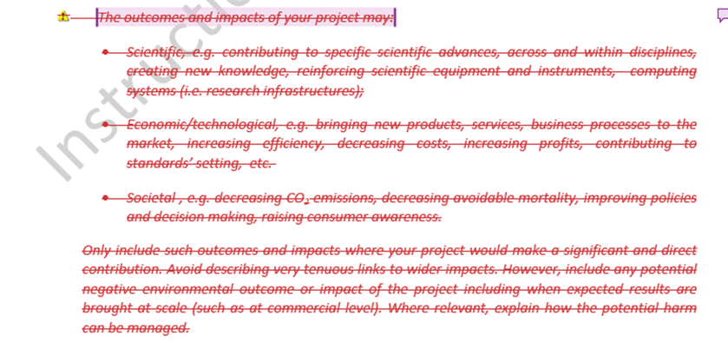
Updates Application form part B – Impact
Where applicable, and excluding ERC, EIC and MSCA actions:
Impact criterion Section 2.1
No longer need to explain the general scientific, economic and societal expected impacts as they are already taken into account in the topic expected impact.

Slide 10
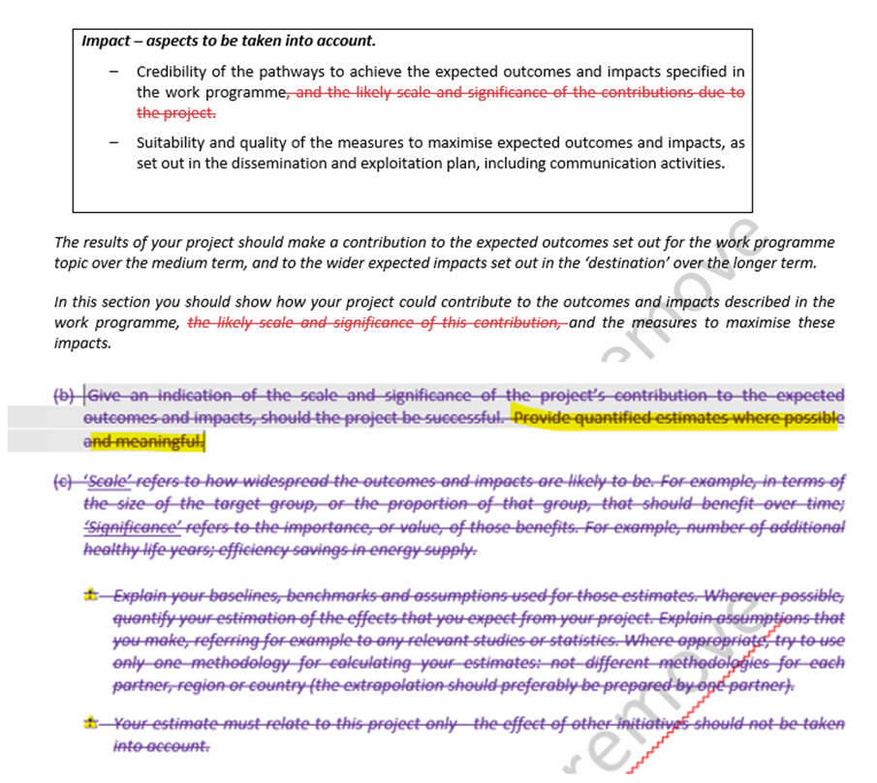
Updates Application form part B – Impact
Where applicable, and excluding ERC, EIC and MSCA actions:
Impact criterion Section 2.1
The “Project’s pathways towards impact” subsection was simplified and the subpoint b) asking a detailed indication of the scale and significance of project contributions was removed from the template. We now ask only to “Provide quantified estimates when possible and relevant”

Slide 11
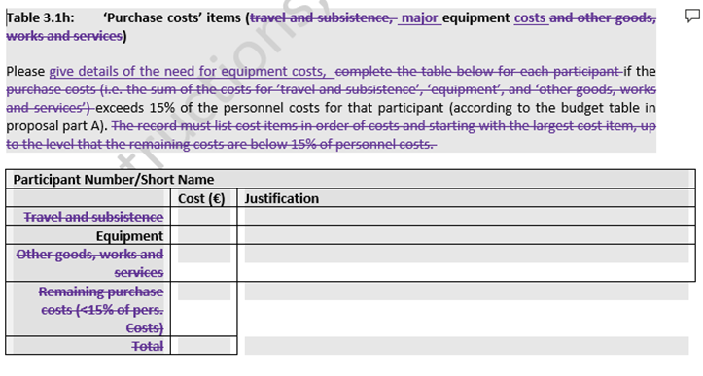
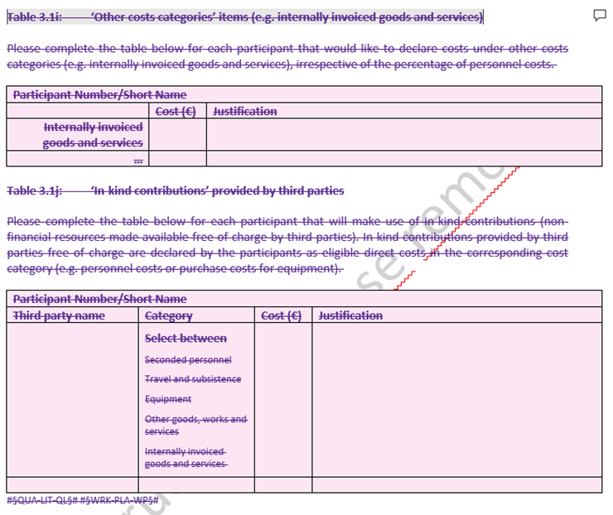
Updates Application form part B – Implementation
Where applicable, and excluding ERC, EIC and MSCA actions:
Implementation criterion
Table 3.1h “Purchase costs” has been simplified and it now only covers equipment costs.
Tables 3.1i “Other costs categories”, and table 3.1j “In-kind contributions” have been removed.
→ For actual costs grants, these tables will be required during GAP as part of the Description of Action of retained for funding proposals.

Slide 12
Reduction in page limits
  Following the simplification of sections 2 and 3, page limits for application form part Bs are reduced by 5 pages. The new standard page limits are
  40 pages for actual costs RIA and IA
  45 pages for lump sum RIA and IA
  25 pages for actual costs CSA
  28 pages for lump sum CSA
  65 pages for HORIZON-COFUND
  40 pages for PCP
  40 pages for PPI
  Specific calls might use different page limits when specifically mentioned in the work programme and call documents.
  !! These changes apply only to calls from Work Programme 2026-2027.
  Calls from Work Programme 2025 and launched in 2026 will use the 2025 templates and page limits.

Slide 13
Reduction of overall TTG in two-stage calls
Horizon Europe

Slide 14
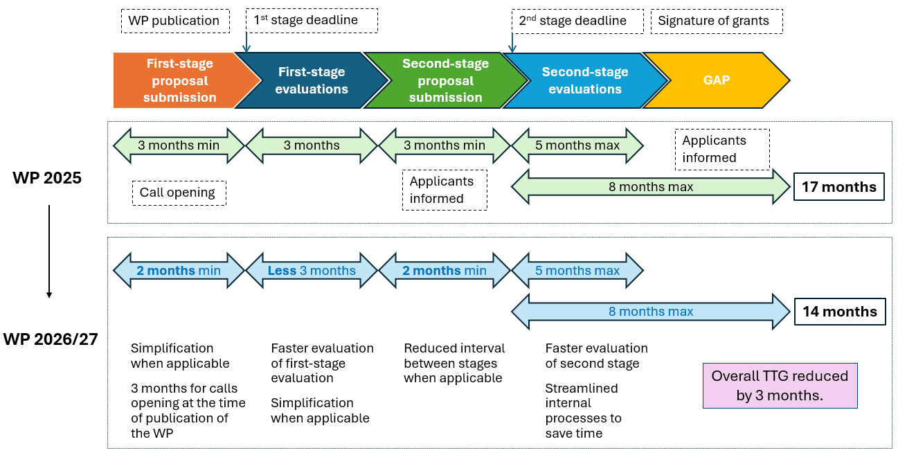
Reduction of overall TTG in two-stage calls
Notes:
When applicable: in some cases it is possible not to have them

Slide 15
Economic Security
Horizon Europe

Slide 16

Economic Security
  Taking into account persistent imbalances concerning innovation-related framework conditions and linked effects, and substantive concerns in relation to the undesired transfer of IP, it is deemed appropriate to restrict eligibility of legal entities established in China, under Article 22(6).
  Restrictions on Innovation Action remain unchanged
  For Research and Innovation Action, legal entities established in China are only eligible for a subset of destinations in Cluster 2, Cluster 5, Cluster 6, Missions, Widening and the New European Bauhaus Facility, or where explicitly mentioned in the call documents
  Participation of entities controlled by China is also restricted under Article 22(5) for Innovation Actions in critical technology areas, where specifically mentioned in the call documents.

Slide 17
Newly associated countries
Horizon Europe

Slide 18

Newly associated countries
  Newly associated countries to Horizon Europe are:
  Republic of Korea (associated to Pillar II ‘Global Challenges and European Industrial Competitiveness’ from budget 2025)
  Switzerland (associated to the entire Programme from budget 2025)
  To be associated countries, under a transitional agreement:
  Egypt (associated to the entire Programme from budget 2025)
  Japan (applicable to Pillar II ‘Global Challenges and European Industrial Competitiveness’, including for the institutionalised European partnerships from budget 2026)

Slide 19
Thank you!
# HorizonEU
http://ec.europa.eu/horizon-europe

